Slide 1

Anyway Predict
2018
Location-aware Traffic Accident Prediction

Slide 2
Dataset
Official car crash DB from ICBS (למ”ס)
Contains reports by Israeli Police (updated regularly), And שומרי הדרך
Anyway Predict
DATAHACK 2018
Notes:
The dataset consists of an official car crash data base from the ICBS containing, for each accident:
1. Timestamp.
2. Latitude, Longitude, and closest population center.
3. Accident type - car damage and victim characteristics.
4. Severity - number of casualties.
5. Road type and conditions.
7. Speed limit.
8. Weather data.
The Data itself is collectied by the Israeli Police and the data base is updated reguarly..

Slide 3
Dataset
Data from - 2008 to 2018
Total 700K records
Focus: 110K crashes in non-urban roads
Contains reports by Israeli Police (updated regularly)
Anyway Predict
DATAHACK 2018
Notes:
The dataset consists of an official car crash data base from the ICBS containing, for each accident:
1. Timestamp.
2. Latitude, Longitude, and closest population center.
3. Accident type - car damage and victim characteristics.
4. Severity - number of casualties.
5. Road type and conditions.
7. Speed limit.
8. Weather data.
The Data itself is collectied by the Israeli Police and the data base is updated reguarly..

Slide 4
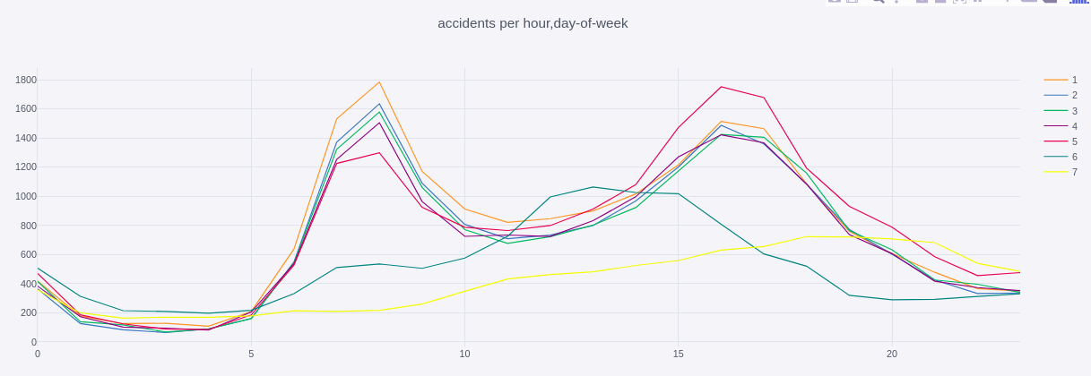
Data Exploration
Anyway Predict
DATAHACK 2018
Notes:
The dataset consists of an official car crash data base from the ICBS containing, for each accident:
1. Timestamp.
2. Latitude, Longitude, and closest population center.
3. Accident type - car damage and victim characteristics.
4. Severity - number of casualties.
5. Road type and conditions.
7. Speed limit.
8. Weather data.
The Data itself is collectied by the Israeli Police and the data base is updated reguarly..

Slide 5
Problem
Given: location and timestamp (driver signal) + ‘sensors’ data
Predict: expected number of car crashes per hour
Anyway Predict
DATAHACK 2018
Notes:
Sensors we used are weather condition (or reports thereof) and road condition (or reports thereof)

Slide 6
Motivation
Inform public
Alert authorities
Practical use - navigation software
= Save Lives!
Anyway Predict
DATAHACK 2018
Notes:
Sensors we used are weather condition (or reports thereof) and road condition (or reports thereof)

Slide 7
Feature Engineering
Geographic data discretization
Temporal data binning with one-hot encoding for day and hour
Weather, Road conditions
Anyway Predict
DATAHACK 2018
Notes:
The dataset consists of an official car crash data base from the ICBS containing, for each accident:
1. Timestamp.
2. Latitude, Longitude, and closest population center.
3. Accident type - car damage and victim characteristics.
4. Severity - number of casualties.
5. Road type and conditions.
7. Speed limit.
8. Weather data.
The Data itself is collectied by the Israeli Police and the data base is updated reguarly..

Slide 8
Solution - First attempt
RF regression on total daily grid cell crash count
Difficulty: sparse data leads to predict of single accident everywhere, anytime
Anyway Predict
DATAHACK 2018

Slide 9
Solution - Next attempt
Sum over time to count accidents per hour-in-a-week in a cell
Gives stable predictions over different samples
MSE: 0.43
Anyway Predict
DATAHACK 2018

Slide 10
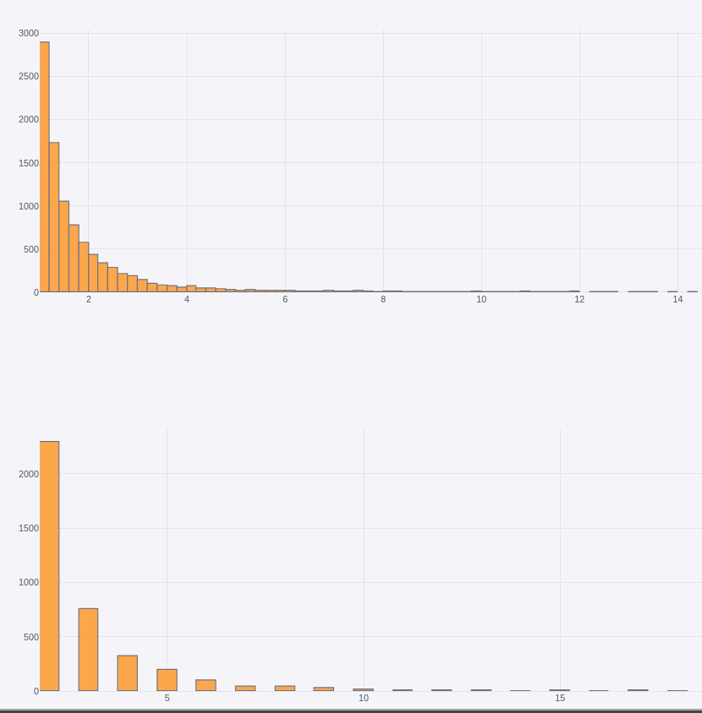
Distribution vs. Prediction
Anyway Predict
DATAHACK 2018

Slide 11
Summary
Link to notebook
Anyway Predict
DATAHACK 2018

